Slide 1

Stress

Slide 2
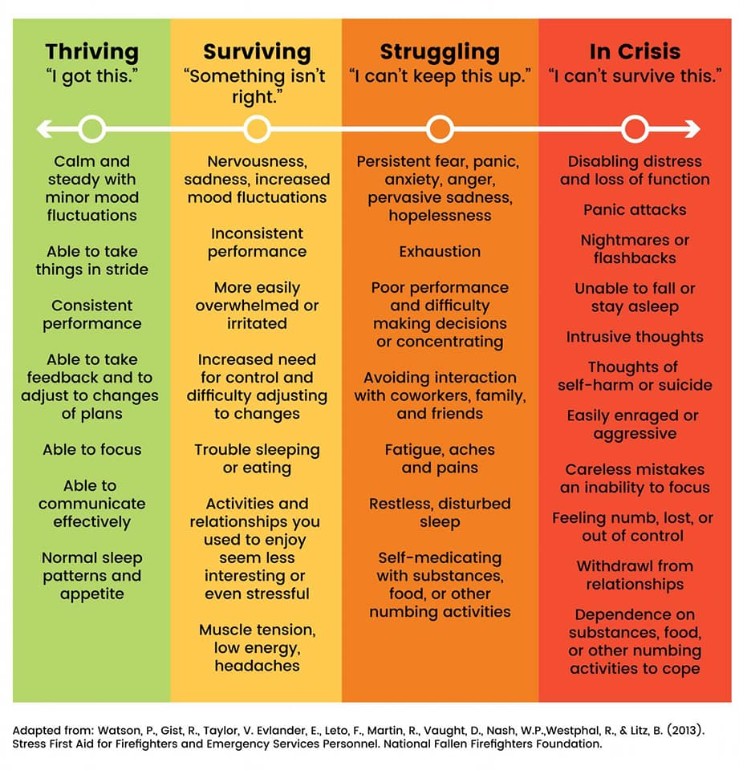

Slide 3
4 sources of stress
Inner Conflict
Life Threat
Loss
Wear and Tear

Slide 4
Inner Conflict
Engaging / witnessing behaviors or acts that violate your values and morals

Slide 5
Life Threat
An experience that provokes fear, helplessness, hopelessness, etc…

Slide 6
Loss
The loss of cherished people, things, or parts of oneself

Slide 7
“Wear and tear”
Accumulation of negative feelings from all sources over time without enough rest/recovery.
This can be a combination of the other 3

Slide 8
Signs of stress
Not feeling in control of one’s body, emotions
or thinking.
Being frequently unable to fall or stay asleep.
Waking up from recurrent or vivid nightmares.
Feeling persistent, intense guilt or shame.
Feeling unusually remorseless.
Experiencing attacks of panic, anger or rage.

Slide 9
Losing memory or the ability to think
rationally.
Being unable to enjoy usually pleasurable
activities.
Losing grounding in previously held moral
values.
Displaying a significant and persistent change
in behavior or appearance.

Slide 10
How can you cope with these symptoms of stress?
Promoting a sense of safety
Promoting a calming feeling
Feeling connected
Sense of self/self efficacy
Sense of hope

